Slide 1
UNIT – 3
CLASSIFICATION OF ELEMENTS AND PERIODICITY IN PROPERTIES
Q) Why do we need to classify elements?

Slide 2
Syllabus
Earlier classification of elements
Modern periodic table
Nomenclature of elements with atomic number > 100
s, p, d and f block
Identification of periods and groups
Periodic trend in properties of elements

Slide 3
Trends in Physical Properties
1)Atomic radii
2)Ionic radius
3)Ionization Enthalpy
4)Electron gain enthalpy – Electron Affinity
5)Electronegativity
Periodic trends in chemical properties:
Anomalous Properties of Second Period Elements
Diagonal relationship
Periodic trends and Chemical reactivity

Slide 4
EARLIER CLASSIFICATION OF ELEMENTS
1. Dobereiner’s Law of Triads:
He made groups of three elements having similar chemical properties called Triad.
In Dobereiner triad, atomic weight of middle element is nearly equal to the average atomic weight of first and third element.
Drawback: All the known elements could not be arranged as triads.
Element | Atomic weight | Element | Atomic weight | Element | Atomic weight
Li | 7 | Ca | 40 | Cl | 35.5
Na | 23 | Sr | 88 | Br | 80
K | 39 | Ba | 137 | I | 127

Slide 5
2. Newland’s law of Octaves:
He arranged the elements in the increasing order of their atomic mass and observed that the properties of every 8th element was similar to the 1st element (like in the case of musical vowels notation).
Drawback: This rule is valid only upto Ca
3)Lother Meyer’s Curve:
He plotted a curve between atomic weight and atomic volume of different elements. Elements having similar properties occupy similar position in curve.
Musical notes | sa | re | ga | ma | pa | dha | ne
 | Li | Be | B | C | N | O | F
 | Na | Mg | Al | Si | P | S | Cl
 | K | Ca

Slide 6
4. Mendeleev’s periodic table:
“The physical and chemical properties of elements are the periodic function of their atomic weight.”
Characteristic of Mendeleev’s periodic table:
It is based on atomic weight.
63 elements were known, noble gases were not discovered.
Gallium and Germanium were not known when Mendeleev presented his periodic table. These elements were named Eka-Aluminium and Eka-Silicon.
Demerits of Mendeleef’s periodic table:
Position of hydrogen
Position of isotopes
Anamalous pairs of elements

Slide 7
5. Modern Periodic table:
Henry Moseley work on the X-ray spectra of the elements reveals that atomic number is a more fundamental property than atomic mass.
Plot a graph √v vs atomic mass
The modern periodic law as “The physical and chemical properties of the elements are periodic functions of their atomic numbers”.
7 horizontal rows (period) and 18 vertical columns (groups).
The first period contains 2 elements. The subsequent periods consists of 8, 8, 18, 18, 32 and 32 elements respectively.
Fourteen elements are contain both sixth and seventh periods i.e., lanthanoids and actinoids respectively are placed in separate panels at the bottom.

Slide 8
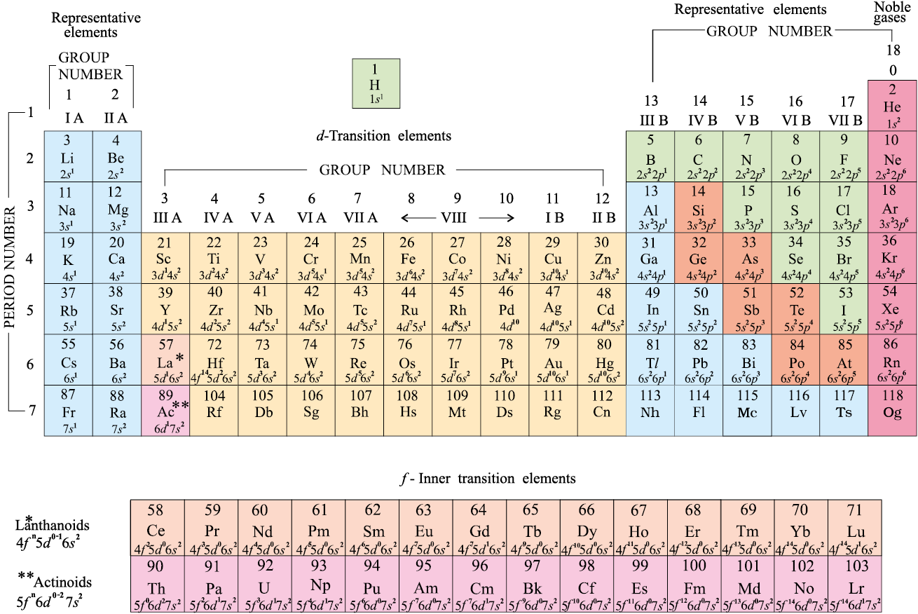

Slide 9
Elements:
1. Metal
Eg:Na,K,Mg
2. Non-metal
Eg:C,O,N
3. Metalloids
Eg:Si,Ge,As

Slide 10
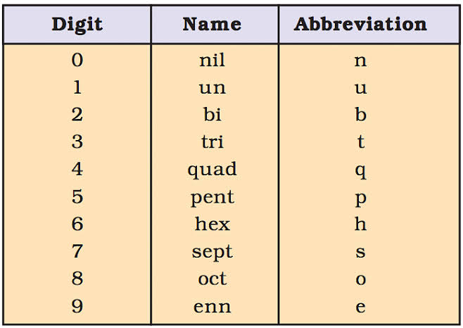
NOMENCLATURE OF ELEMENTS WITH ATOMIC NUMBER > 100

Slide 11
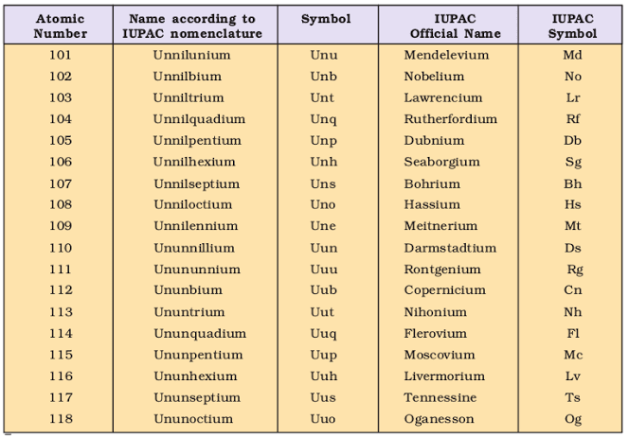

Slide 12
s, p, d and f block
The s- and p- block elements are called main group elements or representative elements.
s- block elements:
• Group-1 (Alkali metals) and Group-2 elements (Alkaline earth metals)
• Electropositive and highly reactive
• Fixed oxidation state (1st group +1, and 2nd group +2)
• All are metals
• GEC is ns¹⁻²

Slide 13
p- Block elements:
• They belongs to group- 13 to 18.
• General electronic configuration is ns² np¹⁻⁶
• Contains metals, non metals and metalloids
• Contains solids, liquid and gases

Slide 14
d- block elements:
• Group 3 to 12
• Also known as Transition elements (Gradual conversion from metallic character to nonmetallic character)
• Various oxidation state and forms coloured compounds
• Used as catalysts and forms alloys
• General electronic configuration (n-1)d¹⁻¹⁰ ns^{0-2 .}

Slide 15
f block elements:
• Two series
Lanthanoids:14 elements from 6th period: Ce(58) – Lu(71) :Coming after Lanthanum
Actinoids: 14 elements from 7th period: Th(90) – Lr(103) : Coming after Actinium
• Also known as Inner transition elements
• Rare earth elements and radioactive elements
• Elements after Uranium is known as Transuranium elements
• GEC is (n-2)f¹⁻¹⁴(n-1)d⁰⁻¹ns²

Slide 16
Identification of periods and groups:
Period number = Highest ‘n’ value
Block: last electron entered subshell
Group number
s-block: number of electrons in the last ‘s’ subshell
p-block: 12 + last ‘p’ subshell electron
d-block: ns+(n –1)d electron
f-block: 3rd grp

Slide 17
PERIODIC TREND IN PROPERTIES OF ELEMENTS
Trends in Physical Properties
1)Atomic radii:Distance between outermost shell and centre of nucleus.
Three types of atomic radius
(a) covalent radius
(b) Vander Waal’s radius
(c) Metallic crystal radius

Slide 18
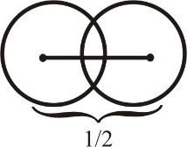
Covalent radius:
Half of the distance between the centre of nucleic of two atoms bonded by single covalent bond.

Slide 19

Vander Waal’s Radius:
Half of the inter nuclear distance between the two non bonded atoms of two neighbouring molecules

Slide 20
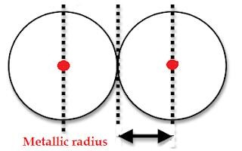
Metallic Radius:
Half of the distance between centres of nucleic of two atoms of metal held together by metallic bond
^{γ}vander ^{> γ}metallic ^{> γ}covalent

Slide 21
Periodic variation of atomic size:
Across a period: It decreases from left to right in a period as nuclear charge increases
Eg: Li > Be > B > C > N > O > F < Ne
In a group: It increases from top to bottom in a group as number of shell increases
Eg: Li < Na < K < Rb < Cs
2)Ionic radius
The ionic radii can be estimated by measuring the distances between cations and anions in ionic crystals.
Note:I⁺< I <I⁻

Slide 22
Isoelectronic species:
These are atom and ions which contain the same number of electrons.
Variation of ionic radius among iso electronic species
Eg: Mg²⁺ < Na⁺ < F⁻ < O²⁻ < N³⁻
Screening effect (σ) and effective nuclear charge (Z_{eff}):
The decrease in force of attraction on valence e⁻ due to inner shell e⁻ is called screening effect or shielding effect.
Screening of subshell: s > p > d > f
Due to screening effect valence shell e⁻ experiences less force of attraction exerted by nucleus (i.e., total attraction force experienced by valence e⁻ is called Z_{eff})

Slide 23
If nuclear charge = Z. Then effective nuclear charge = Z - σ [ Where σ (Sigma) = Screening constant] So, Zeff = (Z - σ)
Order of atomic radius Transition elements
Sc > Ti > V > Cr >Mn> Fe ≈ Co ≈ Ni < Cu < Zn
Zeff > Screening effect Zeff ≈ Screening effect Zeff < Screening effect

Slide 24
3)Ionization Enthalpy
It is also known as ionization potential or ionization energy
which can be defined as the minimum amount of energy required to remove an electron from the valence shell of an isolated gaseous atom in its ground state
Positive in sign and unit is kJ/Mol.
Eg:M(g) → M⁺(g) + e⁻
resulting in the formation of positive ion

Slide 25
Factors affecting ionisation potential:
a)Atomic size:
b)Effective nuclear charge:
c)shielding effect:
d)Half filled and completely filled electron configurations:
Eg: 1)Ist Ionisation potential order is O < N
N : 1s², 2s²2p¹
O : 1s², 2s²2p⁴
2)IInd ionisation potential order
Mg⁺ < Al⁺ < Na⁺
(2, 8, 1) (2, 8, 2) (2, 8)

Slide 26
In a period:
Li Be B C N O F Ne
Atomic size decreases, zeff increases, Ionisation Potential increases
Order of ionisation potential
Eg:Li < B < Be < C < O < N < Fe < Ne
In a group:
Size increase so ionisation potential decrease.
1st group
Eg:Li > Na > K > Rb > Cs

Slide 27
4)Electron gain enthalpy (Δeg H) – Electron Affinity
• Energy released when an electron is added to the outermost orbital of an isolated gaseous atom
• Negative in sign and unit is kJ/Mol
• Group 18 elements has positive Electron gain enthalpy due to completed octet
• Factors affecting
a) Nuclear force of attraction
b)Atomic size

Slide 28
Variation along a period : Increases from left to right (Reason : There is increase in nuclear attraction)
Variation in a group : decreases from top to bottom (Reason : There is decrease in nuclear attraction)
Except
Eg: 16grp ;S>Se>Te>Po>O
17grp;Cl>F>Br>I>As
• Electron gain enthalpy of O is less than S and F less than Cl due to electron-electron repulsion due to their extreme small size
Electron affinity=negative electron gain enthalpy
• Cl has the highest electron affinity

Slide 29
5)Electronegativity:
Electronegativity of an element is the tendency of an atom to attract the shared pair of electrons towards itself. It is not a measurable quantity.
Periodic table and Electronegativity:
(a)Electronegativity decreases down the group
(b) In period on moving from left to right electronegativity increases.
Eg:F>O>N>C>H

Slide 30
Periodic trends in chemical properties:
Periodicity of valence or oxidation state
Group | 1 | 2 | 13 | 14 | 15 | 16 | 17 | 18
Number of Valency electron | 1 | 2 | 3 | 4 | 5 | 6 | 7 | 8
Valency | 1 | 2 | 3 | 4 | 3, 5 | 2, 6 | 1, 7 | 0, 8

Slide 31
Anomalous Properties of Second Period Elements
Due to small size
High Electronegativity
Large charge/radius ratio
Unavailability of ‘d’ orbital
Diagonal relationship:
Group 1 Group 2 Group 3 Group 4
Li Be B C
Na Mg Al Si

Slide 32
Periodic trends and Chemical reactivity
Nature of oxide:
Metal oxide Non-metal oxide
Basic Acidic
Na₂O Al₂O₃, As₂O₃ N₂O, CO, NO CO₂, Cl₂O₇
Basic Amphoteric Neutral Acidic

Slide 33
